Slide 1
Presentation | 2021-12-14
Molecular Dynamics Simulation:
Principles, Algorithms and Applications
Yuzhe Wang
CCME, Peking University
wangyuzhe_ccme@pku.edu.cn

Slide 2
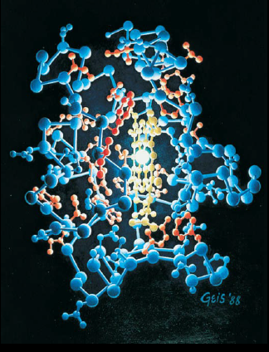
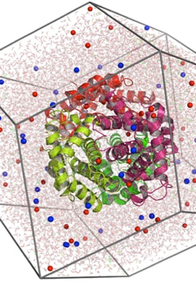

Outline
Background
Proteins: Structure and Functions
Why Molecular Dynamics Simulations?
MD Simulation of Complex Systems
Principles
Simulation of Dynamics of Particles
Molecular Mechanics: Force Field
Preparation to start a Simulation
Algorithms
The Verlet (“leapfrog”) Algorithm
Why Leapfrog Algorithm?
Frontier: Deep Learning for Molecular Dynamics

Slide 3
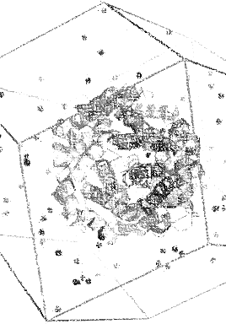
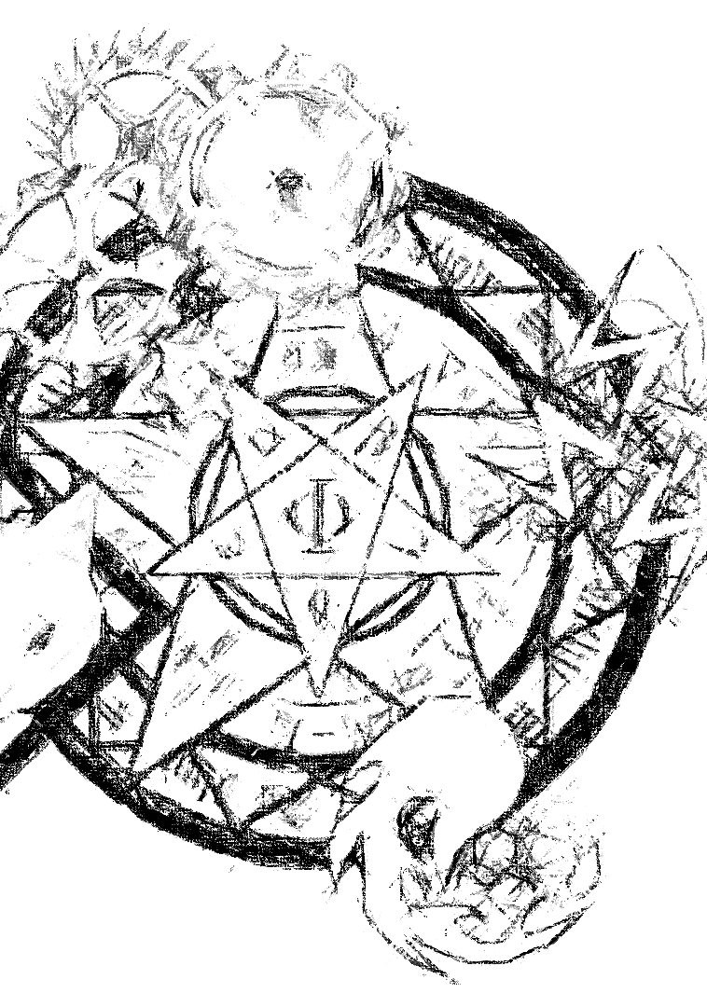
Outline
Background
Proteins: Structure and Functions
Why Molecular Dynamics Simulations?
MD Simulation of Complex Systems
Principles
Simulation of Dynamics of Particles
Molecular Mechanics: Force Field
Preparation to start a Simulation
Algorithms
The Verlet (“leapfrog”) Algorithm
Why Leapfrog Algorithm?
Frontier: Deep Learning for Molecular Dynamics

Slide 4
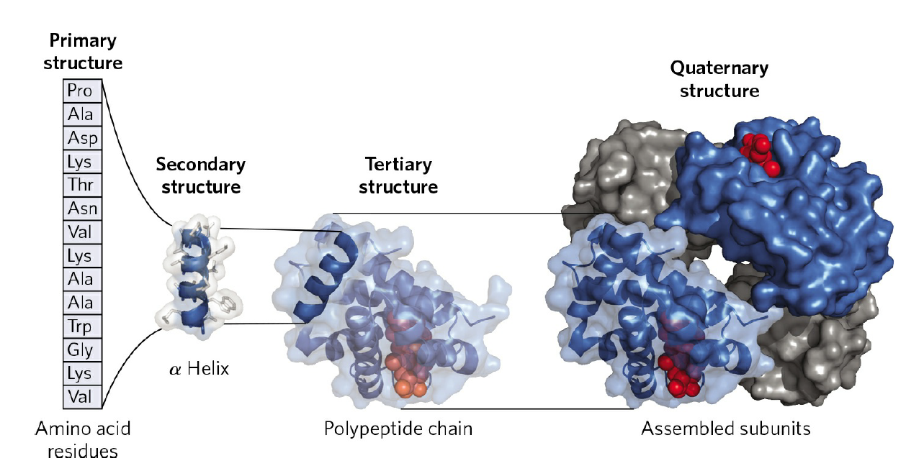
Proteins: Structure and Functions
Protein Structure
3-Dimensional arrangement of atoms in a protein
4 Levels of Structure in Proteins
Protein Functions
Antibodies, Enzymes, Messengers …
Determined by Protein Structure, which is generally difficult to obtain, especially in vivo
Nelson, D. L., Lehninger, A. L., & Cox, M. M. (2008). Lehninger principles of biochemistry. Macmillan.
Notes:
分子动力学模拟在材料科学、生物物理等领域有着广泛应用 而在蛋白质/核酸等生物体系上取得了令人瞩目的突破 下面主要讲这一部分
一级结构：多肽链中的氨基酸序列
二级结构：蛋白质局部的主链原子空间排布 例如$α螺旋$和$β折叠$
三级结构：多肽链全部原子的三维空间排布（=三维结构）
四级结构：独立折叠的蛋白单体通过非共价相互作用（氢键、范德华力、离子静电作用等）彼此缔合形成聚集体

Slide 5
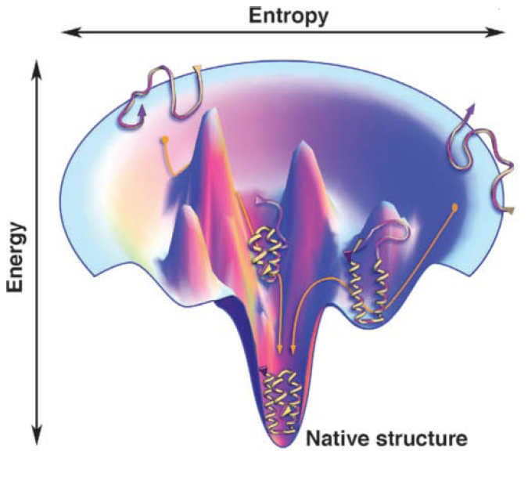
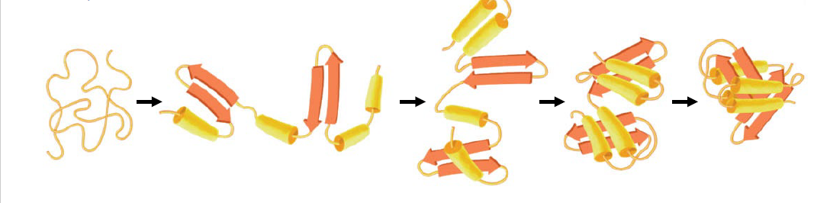
Why Molecular Dynamics Simulations?
Protein Structure Prediction: Dive into Protein Folding
Thermodynamics: free-energy funnel
Low energy conformation is spontaneously formed, consistent with the protein structure in vivo
Nelson, D. L., Lehninger, A. L., & Cox, M. M. (2008). Lehninger principles of biochemistry. Macmillan.
Notes:
获得蛋白质结构的重要性
冷冻电镜（施一公）：不能in vivo
折叠层次
折叠漏斗
高能高熵 无序状态→低能低熵 天然结构

Slide 6
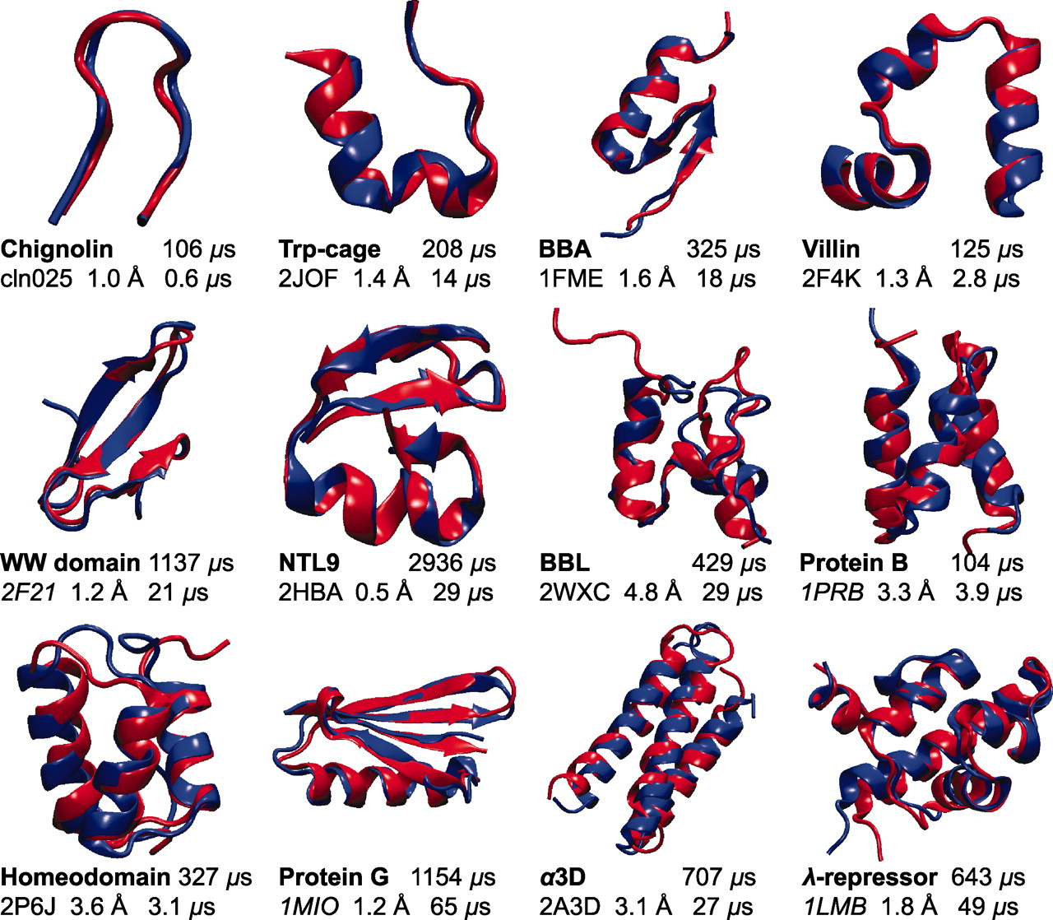
Why Molecular Dynamics Simulations?
Protein Structure Formation: Dive into Protein Folding
Protein Structure Prediction: Protein Folding Simulations
Lindorff-Larsen, K., Piana, S., Dror, R. O., & Shaw, D. E. (2011). How fast-folding proteins fold. Science, 334(6055), 517-520.
Notes:
D. E. Shaw 2011年的Science文章 红色是实验确定的蛋白质实际结构 蓝色是动力学模拟得到的折叠结构 下面有模拟时长 可见动力学模拟获得的结构与实际结构非常接近
（D. E. Shaw的传奇故事 2021年Anton3）

Slide 7
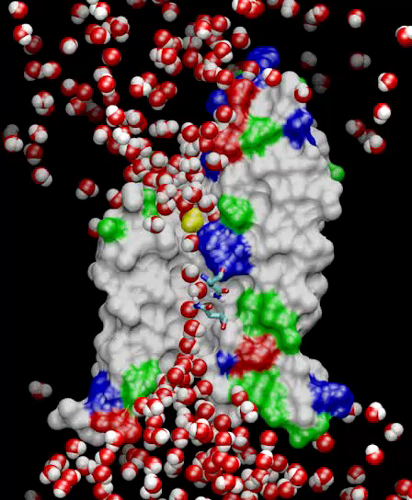
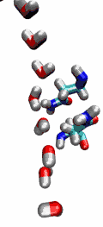
MD Simulation of Complex Systems
MD Simulation: A glimpse of life processes inside our cells
A Fancy Example: the Selectivity of the Aquaporin Water Channel (Science 2002)
Tajkhorshid, E., Nollert, P., Jensen, M. Ø., Miercke, L. J., O'Connell, J., Stroud, R. M., & Schulten, K. (2002). Control of the selectivity of the aquaporin water channel family by global orientational tuning. Science, 296 (5567), 525-530.
Notes:
水通道蛋白的选择性 分子动力学模拟 一举弄清水通道蛋白的工作原理
水分子经过水通道蛋白时 会排成单一纵列 进入弯曲狭窄的通道中 通道内部的偶极力与极性会帮助水分子旋转 以适当角度穿过通道 水通道蛋白的蛋白构象使得只有水分子能够通过
当然 分子动力学模拟的应用远不止于此 例如（我们组在做的）药物分子结合自由能的计算（Free Energy Pertubation）可以非常精确地计算结合自由能，对药物设计有着重要的意义 限于时间不展开介绍

Slide 8
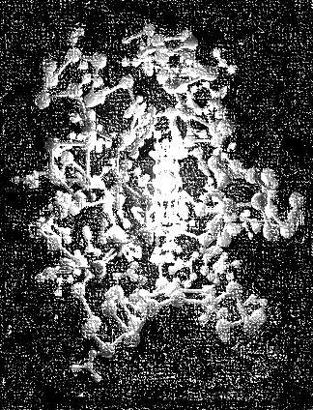
Outline
Background
Proteins: Structure and Functions
Why Molecular Dynamics Simulations?
MD Simulation of Complex Systems
Principles
Simulation of Dynamics of Particles
Molecular Mechanics: Force Field
Preparation to start a Simulation
Algorithms
The Verlet (“leapfrog”) Algorithm
Why Leapfrog Algorithm?
Frontier: Deep Learning for Molecular Dynamics

Slide 9
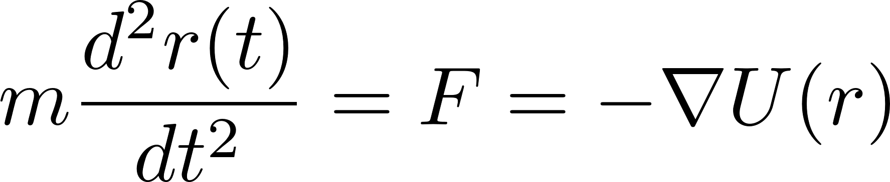
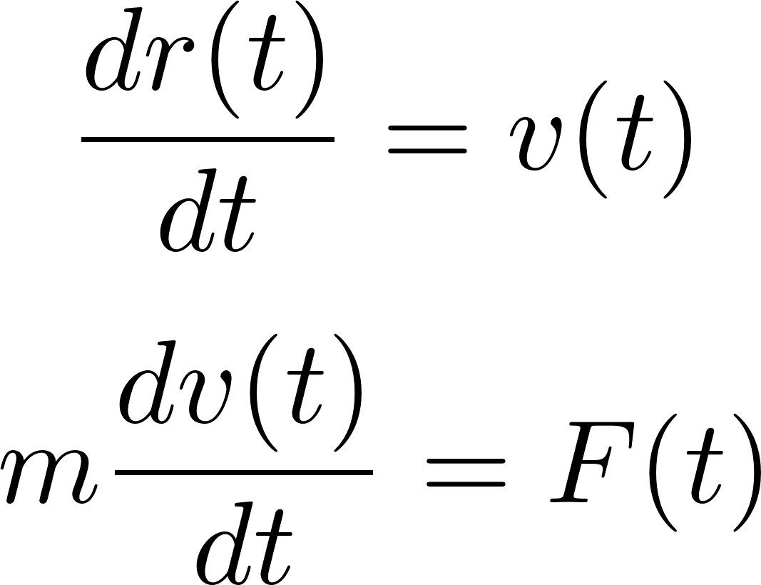
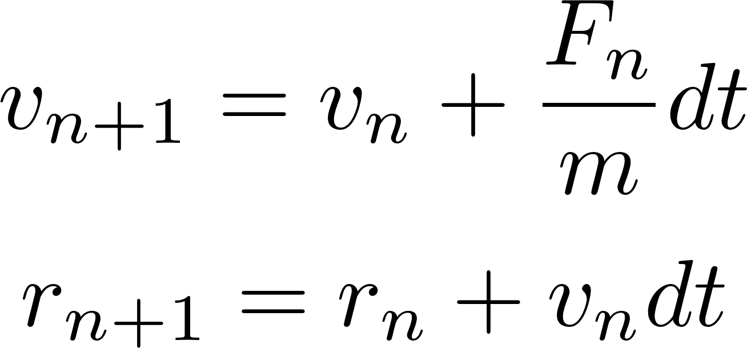
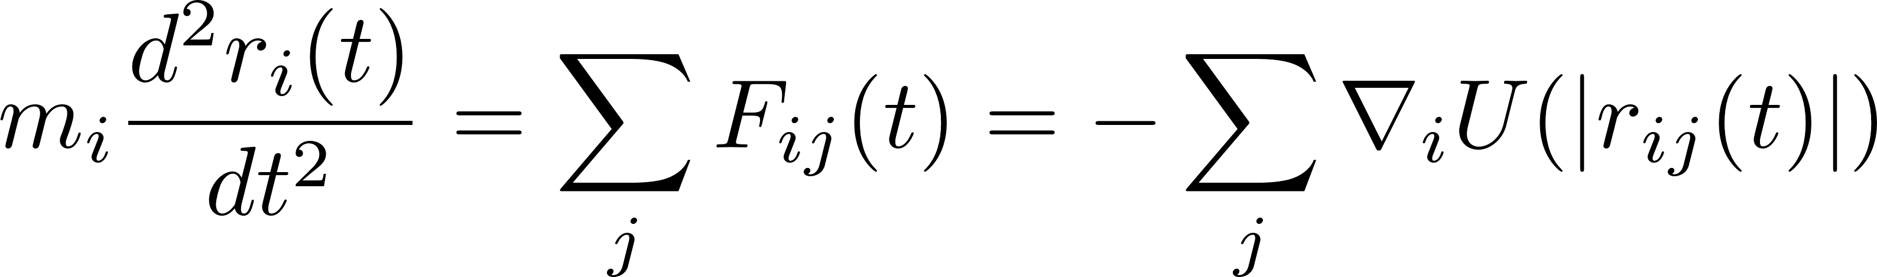
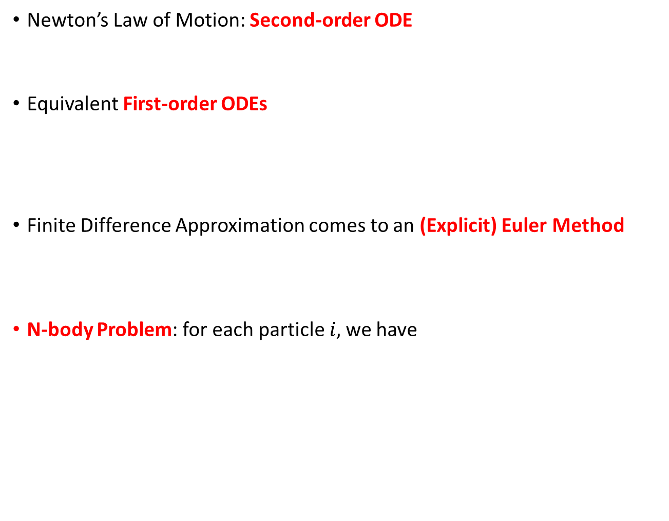
Simulation of Dynamics of Particles
Newton’s Law of Motion: Second-order ODE
Equivalent First-order ODEs
Finite Difference Approximation comes to an (Explicit) Euler Method
N-body Problem: for each particle $i,$we have
Leimkuhler, B., & Matthews, C. (2016). Molecular Dynamics. Springer International PU.
Notes:
二阶常微分方程
高阶ODE初值问题可以化为等价的一阶ODE组的初值问题（课上讲授）
一种最straight-forward的想法：有限差分近似 转化为显式欧拉方法
但实际是problematic的！数值稳定性不够好 后续Algorithms部分讲述
多体问题

Slide 10
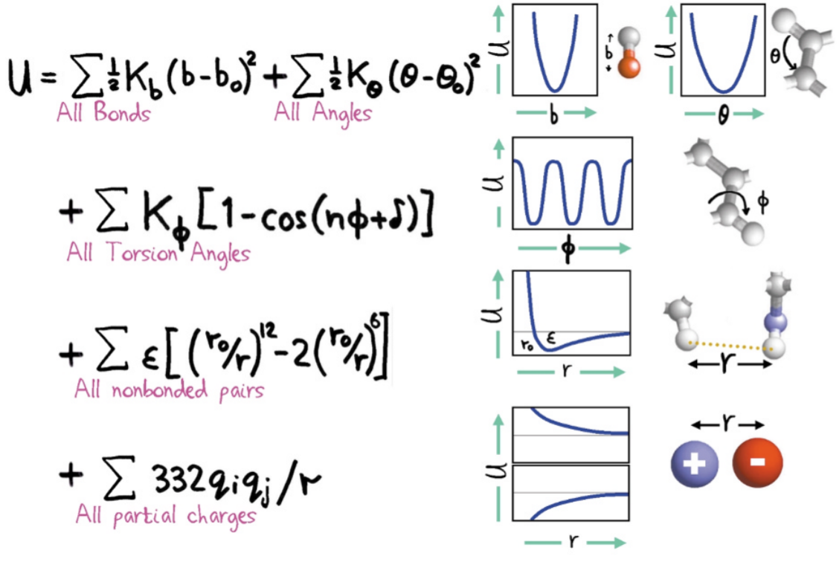
Molecular Mechanics: Force Field
Potential Energy Function
Force Field: the function form of the potential and a set of parameters for different types of atoms, bonds and interactions etc.
A general (empirical) force field
Leimkuhler, B., & Matthews, C. (2016). Molecular Dynamics. Springer International PU.
Levitt, M. (2001). The birth of computational structural biology. Nature structural biology, 8(5), 392-393.
Notes:
如何获得势函数？注意我们实际处理的是分子
（对生物体系）一个一般的力场形式
成键相互作用：键能项（键的拉伸振动，谐振子势函数）+角弯折项+扭转势垒
非键相互作用：范德华相互作用（Lennard-Jones势）+静电相互作用

Slide 11
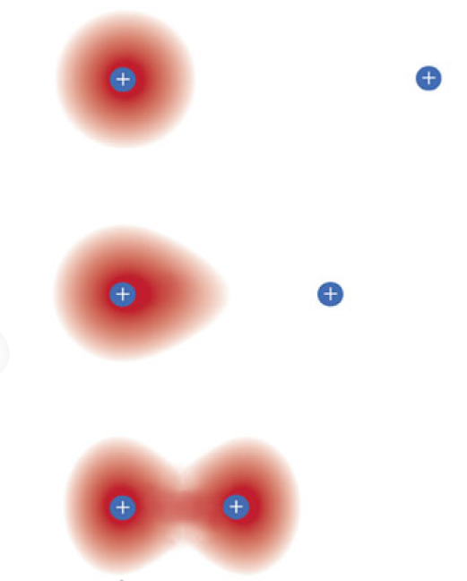
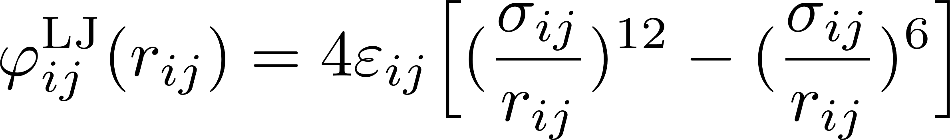
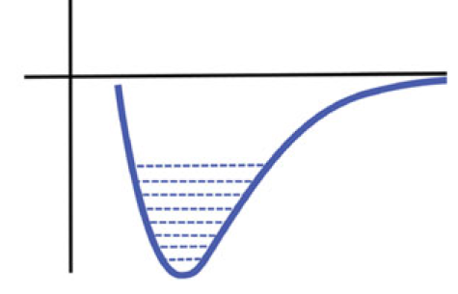
Molecular Mechanics: Force Field
Potential Energy Function
Force Field: the function form of the potential and a set of parameters for different types of atoms, bonds and interactions etc.
A general (empirical) force field
Van der Waals Interaction: Lennard-Jones Potential
London dispersion
↓
↑
Pauli repulsion
Leimkuhler, B., & Matthews, C. (2016). Molecular Dynamics. Springer International PU.
Levitt, M. (2001). The birth of computational structural biology. Nature structural biology, 8(5), 392-393.
Notes:
L-J势 形式上与前一页有区别是因为选取$r_{0}和σ是$不同的 本质没有差异
后一项是伦敦色散力（吸引力，距离-6次方），前一项是泡利排斥力（距离-12次方）

Slide 12
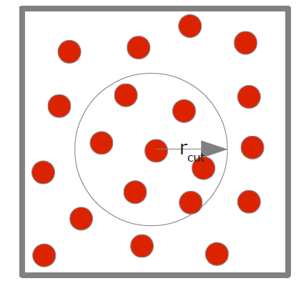

Molecular Mechanics: Force Field
Potential Energy Function
Force Field: the function form of the potential and a set of parameters for different types of atoms, bonds and interactions etc.
A general (empirical) force field
Van der Waals Interaction: Lennard-Jones Potential
The Potential Cut-off
In principle pair potentials have infinite range
For potentials like Lennard-Jones potential the value quickly becomes negligible when atoms gradually separate
Apply an (empirical) cut-off condition
Leimkuhler, B., & Matthews, C. (2016). Molecular Dynamics. Springer International PU.
Smith, W. (2014). Elements of molecular dynamics. GitLab. https://gitlab. com/DL_POLY_Classic/EoMD.
Notes:
截断
只有在$r_{cut}范围$内的相互作用被考虑

Slide 13
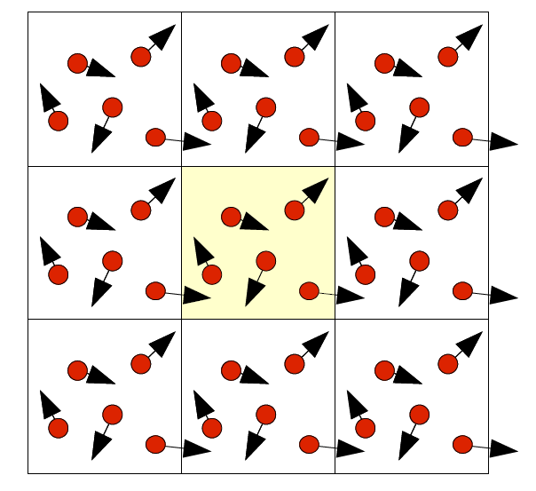
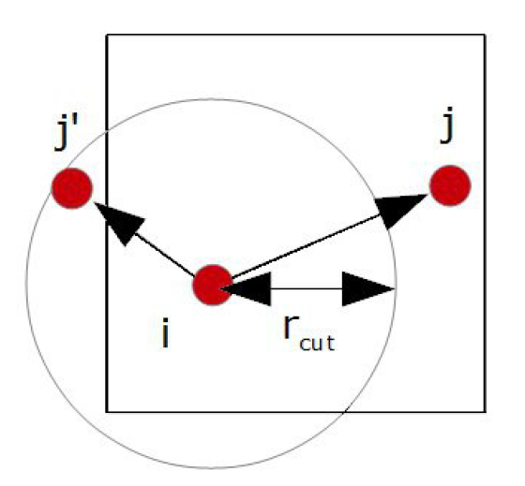
Preparation to start a Simulation
The Periodic Boundary Condition (PBC)
The system is in fact infinite in extent
Idea: the periodic cell is assumed to be replicated in the same way as a unit cell in crystallography
Purpose: create a system without surfaces
The Minimum Image Convention
The cut-off setting: Net interaction experienced by each atom includes contribution from only one image of the other atom in the system
Purpose: only the closest images of any two atoms contribute to the calculated energy / force
The Initial Conditions
Initial atom positions: usually obtained by x-ray crystallography or cryo-em (NOT in vivo!)
Initial velocities: usually generated from a series of random seeds, then scaled to match the required system temperature
Smith, W. (2014). Elements of molecular dynamics. GitLab. https://gitlab. com/DL_POLY_Classic/EoMD.
Notes:
周期性边界条件（类比解PDE的边界条件）
粒子从右侧穿出 镜像地从左侧进入 完全周期性
表面通常会具有不平凡的物理化学性质（“表面化学”）
最小像约定
X射线晶体学或冷冻电镜
一般地，可以根据Gaussian distribution生成starting velocities
以上知识已经足够编写程序进行一次动力学模拟了！
下面讲解Integration Algorithms：求解ODE初值问题

Slide 14
Outline
Background
Proteins: Structure and Functions
Why Molecular Dynamics Simulations?
MD Simulation of Complex Systems
Principles
Simulation of Dynamics of Particles
Molecular Mechanics: Force Field
Preparation to start a Simulation
Algorithms
The Verlet (“leapfrog”) Algorithm
Why Leapfrog Algorithm?
Frontier: Deep Learning for Molecular Dynamics

Slide 15

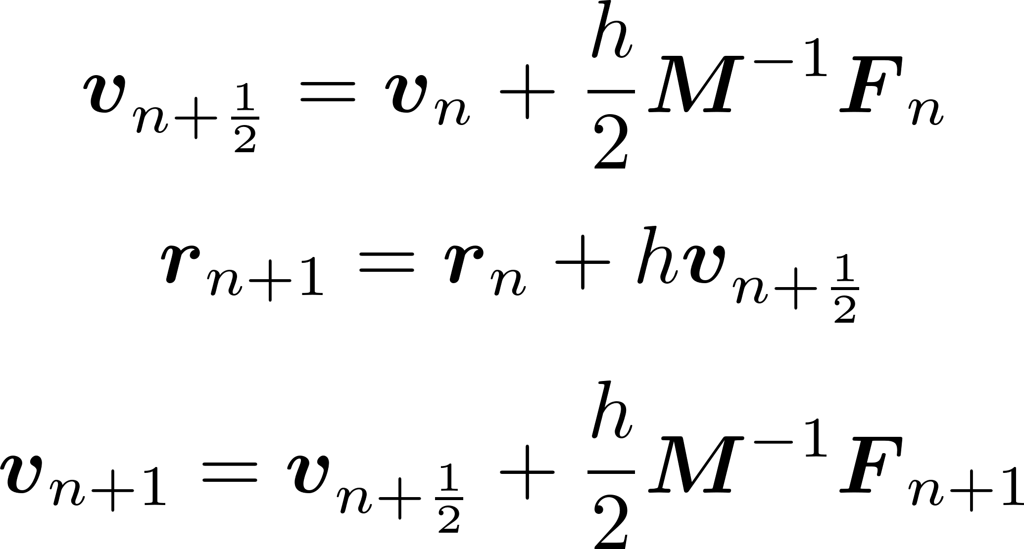
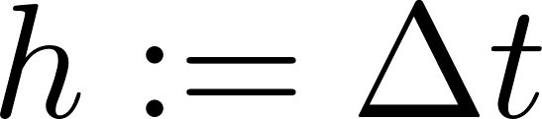
The Verlet (“leapfrog”) Algorithm
Algorithm
where denotes the (fixed) time interval, and the force
computed at the end of a given step is reused at the start of the following step, lead to a similar cost to Euler Method
“Leapfrog”
Update positions and velocities at interleaved time points, staggered in such a way that they "leapfrog" over each other.
Störmer’s Rule
Eliminate velocities to obtain
Leimkuhler, B., & Matthews, C. (2016). Molecular Dynamics. Springer International PU.
Notes:
实际上Verlet算法包括很多变种 但Verlet Velocity即leapfrog算法在MD Simulation中是最为广泛使用的 几乎已经成为了MD的一个代表 下面讲的Verlet算法均是指的leapfrog算法
Integration Algorithms：求解ODE初值问题
粗斜体是多维向量/矩阵
每个timestep只需要做一次force evaluation，而计算force是很expensive的（主要cost来源）
交错计算位置和速度
Stormer’s rule 1900年代提出 是verlet 1967年用于MD Simulation的灵感来源
1)-3)，代入2)，略微调整序号即得

Slide 16
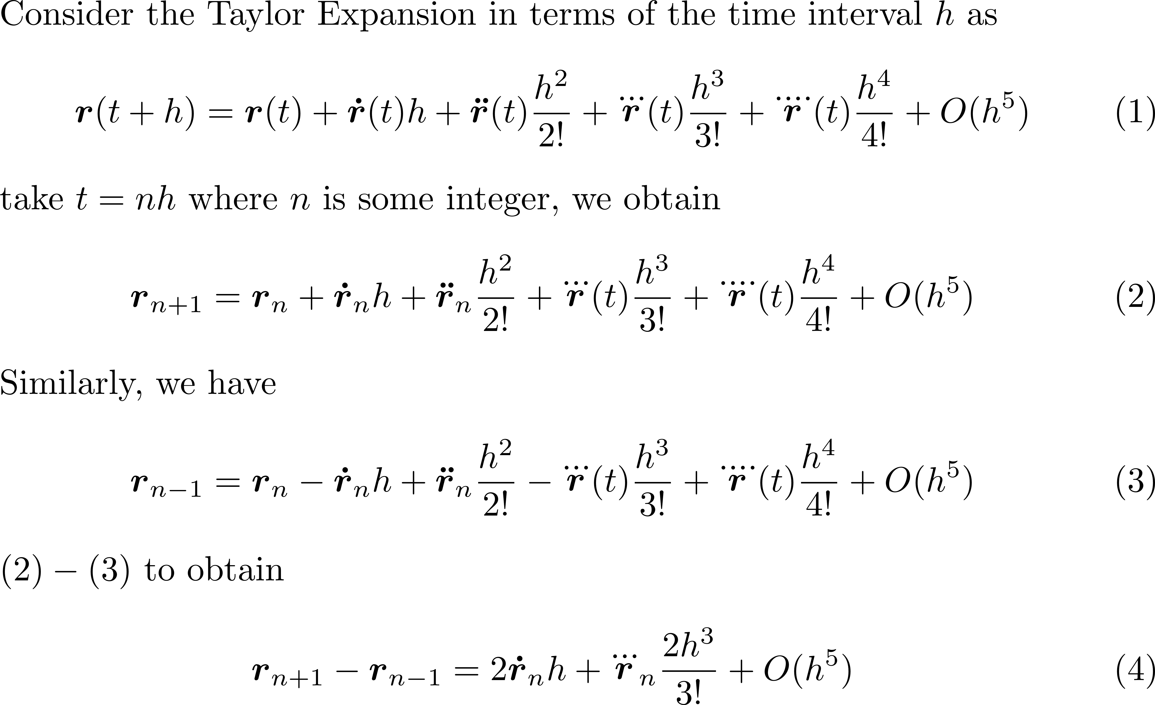
The Verlet (“leapfrog”) Algorithm
Brief Derivation of leapfrog algorithm
Leimkuhler, B., & Matthews, C. (2016). Molecular Dynamics. Springer International PU.
Smith, W. (2014). Elements of molecular dynamics. GitLab. https://gitlab. com/DL_POLY_Classic/EoMD.
Notes:
简要推导leapfrog algorithm

Slide 17
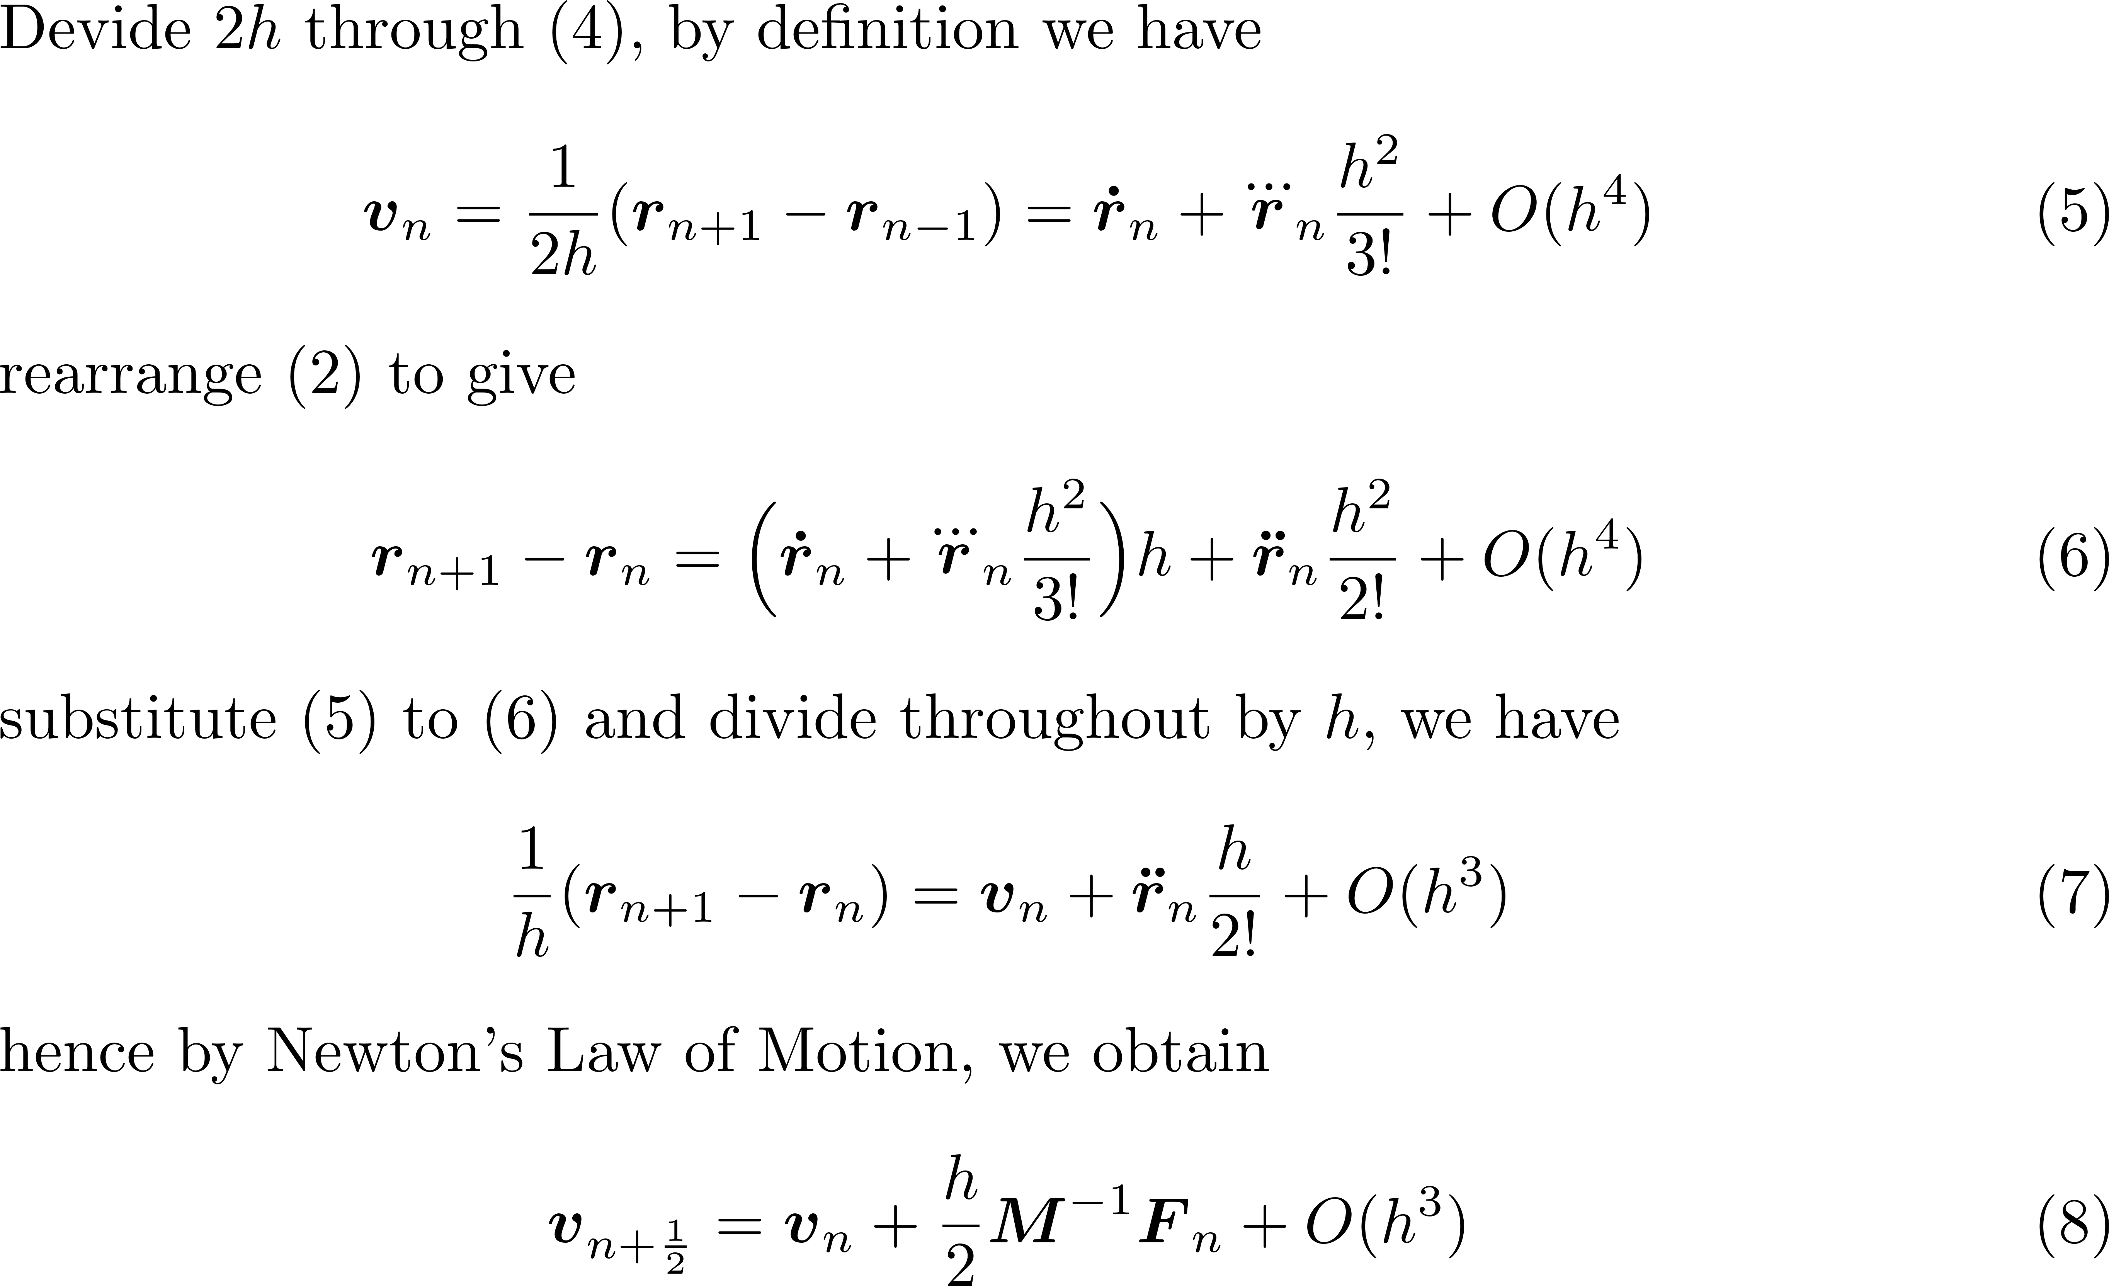
The Verlet (“leapfrog”) Algorithm
Brief Derivation of leapfrog algorithm
Leimkuhler, B., & Matthews, C. (2016). Molecular Dynamics. Springer International PU.
Smith, W. (2014). Elements of molecular dynamics. GitLab. https://gitlab. com/DL_POLY_Classic/EoMD.
Notes:
简要推导leapfrog algorithm

Slide 18
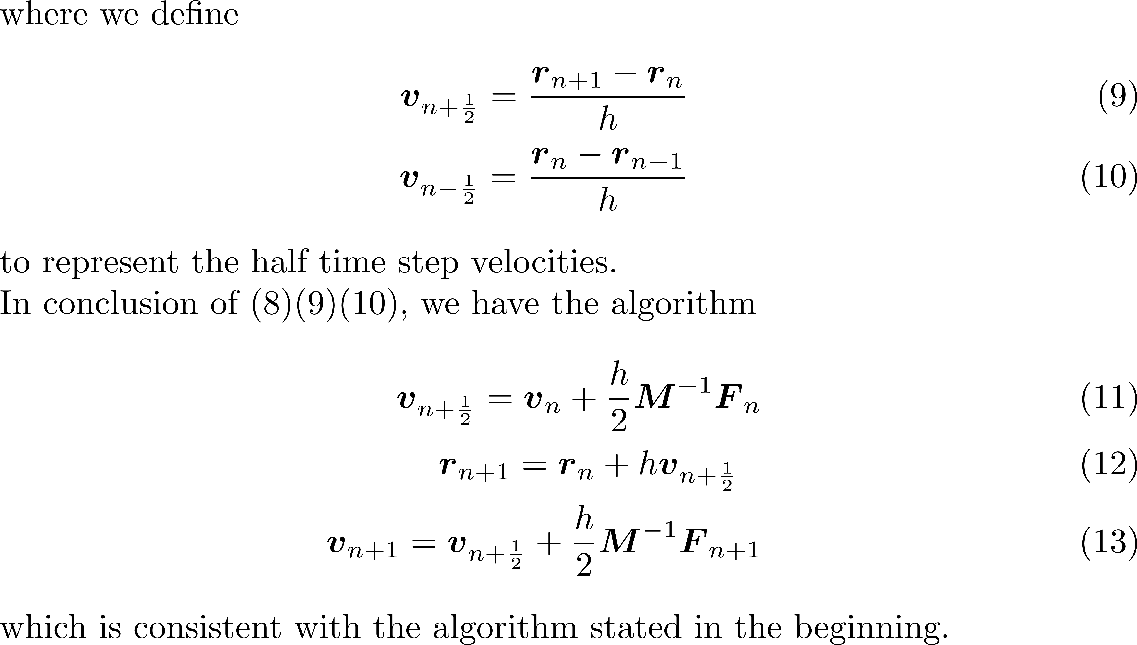
The Verlet (“leapfrog”) Algorithm
Brief Derivation of leapfrog algorithm
Leimkuhler, B., & Matthews, C. (2016). Molecular Dynamics. Springer International PU.
Smith, W. (2014). Elements of molecular dynamics. GitLab. https://gitlab. com/DL_POLY_Classic/EoMD.
Notes:
简要推导leapfrog algorithm

Slide 19
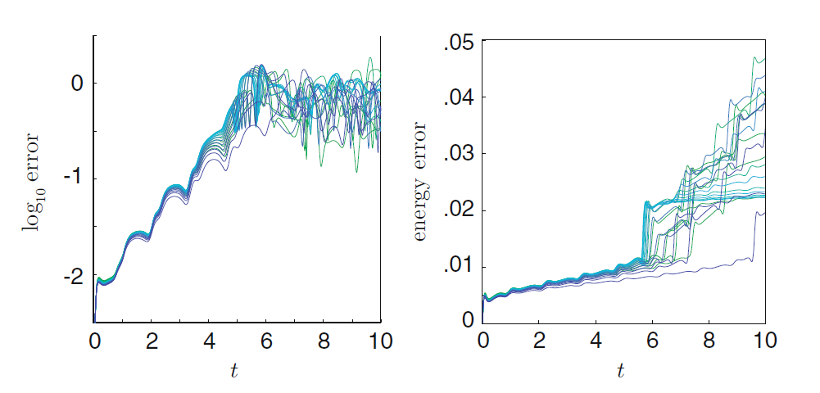
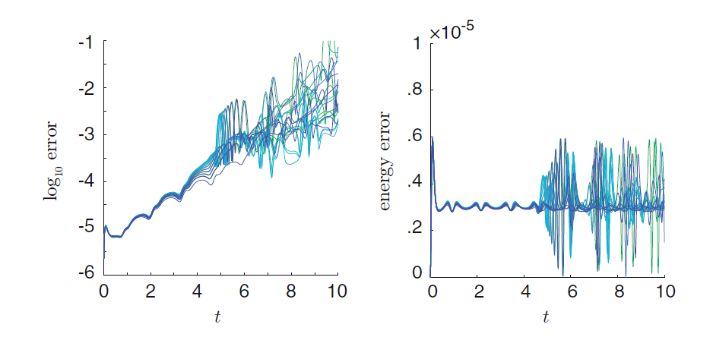
Why Leapfrog Algorithm?
Leapfrog Algorithm: Second-Order Method (Proof is omitted)
Why not apply higher-order Runge-Kutta Method (e.g. RK4)?
Error Growth in Numerical Integration of ODEs
Euler’s Method
Leapfrog Algorithm
Leimkuhler, B., & Matthews, C. (2016). Molecular Dynamics. Springer International PU.
Notes:
为什么不用欧拉方法？我们直接的回答可能是 是不是leapfrog阶数更高？但是为什么不用RK4？
动力学模拟的特殊之处就在于 动力学模拟得到的轨迹需要足够长 因此在长时间模拟中误差如何积累是非常重要的
图：三原子体系（trimer）的轨迹误差随时间增长（左）和能量误差随时间增长（右），注意右图纵坐标数量级不同
20次不同初始条件 同样初始能量 图示出numerical trajectories

Slide 20
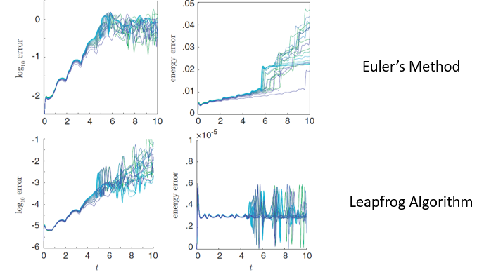
Why Leapfrog Algorithm?
Leapfrog Algorithm: Second-Order Method (Proof is omitted)
Why not apply higher-order Runge-Kutta Method (e.g. RK4)?
Error Growth in Numerical Integration of ODEs
Molecular dynamics trajectories need to be very long compared to the time step, thus how the error grows in long simulations is essential
Chaotic nature of molecular dynamics, sensitivity to perturbations, the global error is expected to grow rapidly (exponentially) in time unavoidably
However, leapfrog algorithm has significant stability of energy that the energy error DO NOT accumulate in time
This is actually an extremely non-trivial property! Many common numerical algorithms of ODE is not suitable for MD Simulation for this reason.
Leimkuhler, B., & Matthews, C. (2016). Molecular Dynamics. Springer International PU.
Notes:
动力学模拟的特殊之处就在于 动力学模拟得到的轨迹需要足够长 因此在长时间模拟中误差如何积累是非常重要的

Slide 21
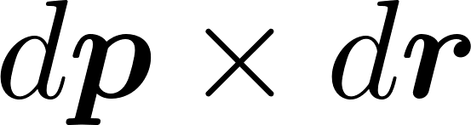
Why Leapfrog Algorithm?
A glimpse of the essence: Geometric Integrators for Hamiltonian Systems
Methods that conserve a certain geometric property i.e. Symplecticness of the phase flow
Mathematically, symplecticness is the property that is a conserved quantity
Symplectic methods (e.g. leapfrog algorithm) preserve a perturbed energy-like invariant i.e. these algorithms possess in-built long term stability (proof is omitted)
Leimkuhler, B., & Matthews, C. (2016). Molecular Dynamics. Springer International PU.
Smith, W. (2014). Elements of molecular dynamics. GitLab. https://gitlab. com/DL_POLY_Classic/EoMD.
Notes:
辛性 守恒量 辛结构Symplectic geometry
哈密顿系统：哈密顿方程描述

Slide 22
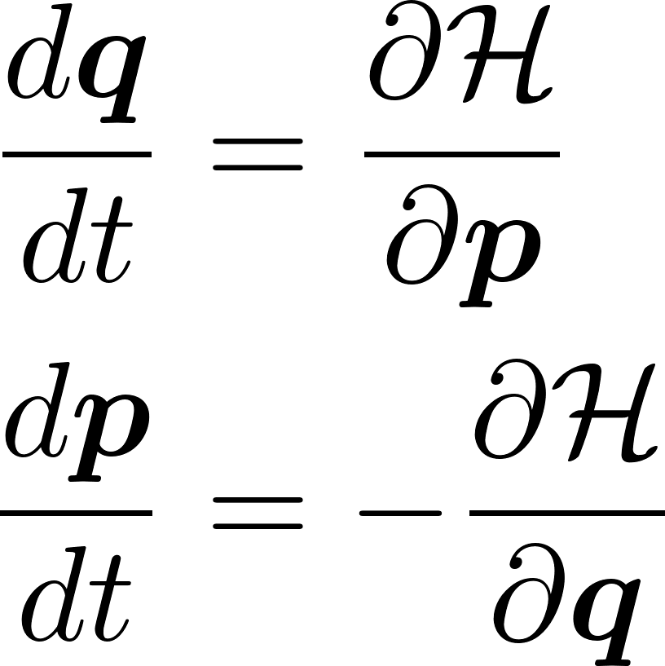
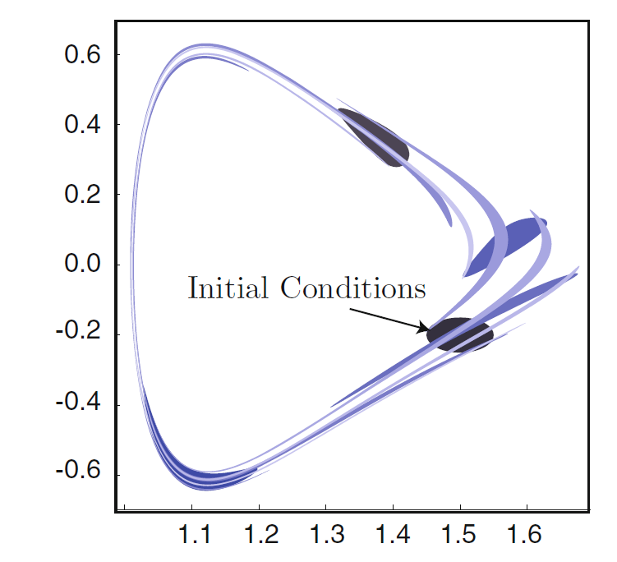
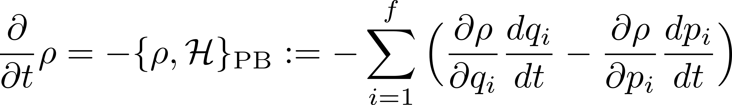
Why Leapfrog Algorithm?
A glimpse of the essence: Geometric Integrators for Hamiltonian Systems
The Dynamics of a Hamiltonian system
Hamilton’s Equations
Highly restricted by conservation laws or volume preservation, violation of which leads to a gradual corruption of the solution
Volume Preserving Flows: Liouville’s Theorem
Leimkuhler, B., & Matthews, C. (2016). Molecular Dynamics. Springer International PU.
Smith, W. (2014). Elements of molecular dynamics. GitLab. https://gitlab. com/DL_POLY_Classic/EoMD.
Notes:
哈密顿系统：哈密顿方程描述
哈密顿量H 是拉格朗日量L=T-V（动能-势能）经过勒让德变换得到 详见理论力学
p广义动量 q广义坐标
哈密顿系统的（相体积）流一定满足刘维尔定理
PB：泊松括号 f：自由度
非常优雅而深刻（e.g. 量子刘维尔定理）

Slide 23
Why Leapfrog Algorithm?
A glimpse of the essence: Geometric Integrators for Hamiltonian Systems
The Dynamics of a Hamiltonian system
Connection between MD Simulations and Hamiltonian System?
Quick intro to Statistical Mechanics: Microcanonical Ensemble (NVE Ensemble), energy as a conserved quantity
Hamiltonian systems, satisfy Liouville Theorem
Hence symplecticness of algorithms is required
The Symplecticness of Leapfrog Algorithm
The Symplectic nature of the leapfrog algorithm can be shown by deriving the algorithm directly from the Liouville Equation or Hamilton’s principle of least action
(The latter) finally leads to
which is Störmer’s Rule!
Leimkuhler, B., & Matthews, C. (2016). Molecular Dynamics. Springer International PU.
Smith, W. (2014). Elements of molecular dynamics. GitLab. https://gitlab. com/DL_POLY_Classic/EoMD.
Notes:
统计物理：微正则系综（详见：平衡态统计物理）
统计系综：想象大量结构完全相同的系统 处在相同的宏观条件下 这些大量系统的集合就是统计系综 可以认为是相空间的一个分布
务必注意：不是物理空间 而是相空间
哈密顿最小作业量原理

Slide 24
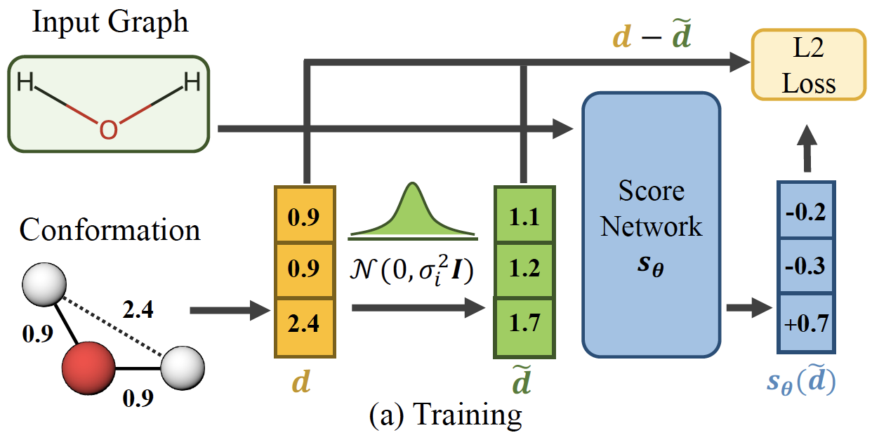
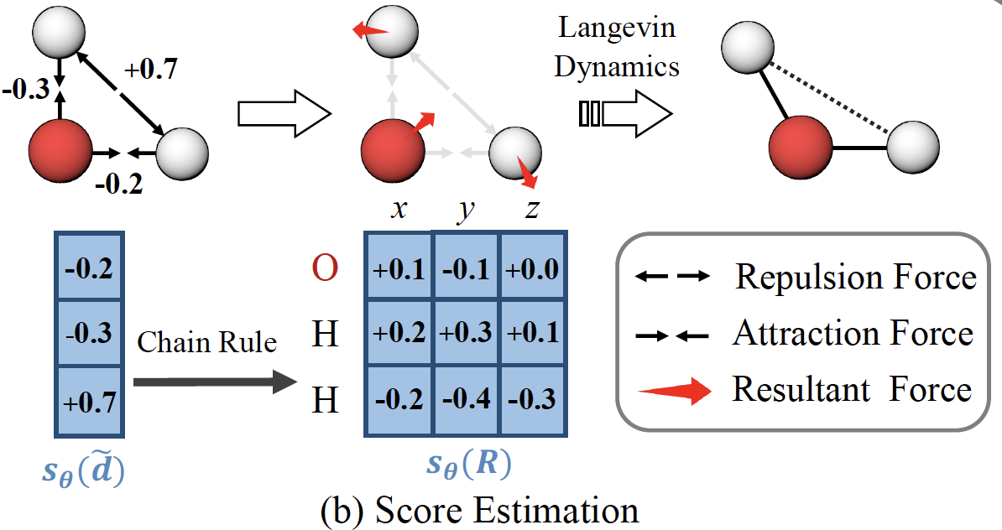
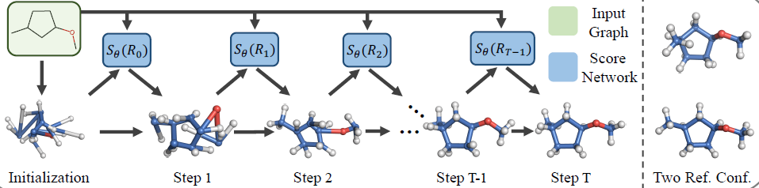
Frontier: Deep Learning for Molecular Dynamics
ConfGF (ICML’21)
Learning a Force Field via Graph Isomorphism Network (GINs)
Perform Dynamics Simulation (Conformation Optimization) via Langevin Dynamics
Shi, C., Luo, S., Xu, M., & Tang, J. (2021). Learning gradient fields for molecular conformation generation. arXiv preprint arXiv:2105.03902.
Notes:
时间有限 MD Simulation博大精深 实在没法完全讲述（例如在leapfrog基础上非常重要的 限制分子内的键的运动的SHAKE算法）
讲一些深度学习在MD方面的应用 也算是算法的一部分
Graph Isomorphism Network (GINs)
图同构网络 是GNN的一种
基于深度学习的力场实现小分子构象的生成和优化 也是动力学模拟的常见问题了
为了精确计算小分子在特定构象下的能量，我们通常需要采用基于量子力学的方法，这些方法非常耗费时间和计算资源。基于经验的力场函数虽然计算起来更快，但是缺乏准确性。
在GEOM数据集上学习＞33 million小分子的构象信息 能够直接形成一个极其可信的力场
模拟退火

Slide 25
References
[1] Leimkuhler, B., & Matthews, C. (2016). Molecular Dynamics. Springer International PU.
[2] Smith, W. (2014). Elements of molecular dynamics. GitLab. https://gitlab. com/DL_POLY_Classic/EoMD.
[3] Leach, A. R., & Leach, A. R. (2001). Molecular modelling: principles and applications. Pearson education.
[4] Krauth, W. (2006). Statistical mechanics: algorithms and computations (Vol. 13). OUP Oxford.
[5] Rapaport, D. C., & Rapaport, D. C. R. (2004). The art of molecular dynamics simulation. Cambridge university press.
[6] Frenkel, D., Smit, B., & Ratner, M. A. (1996). Understanding molecular simulation: from algorithms to applications (Vol. 2). San Diego: Academic press.
[7] Nelson, D. L., Lehninger, A. L., & Cox, M. M. (2008). Lehninger principles of biochemistry. Macmillan.

Slide 26
Thank you
Yuzhe Wang
CCME, Peking University
wangyuzhe_ccme@pku.edu.cn

